Slide 1
Pitch Clock Analysis
James Carney, Aidan Dowd, Mitchell Flattum, Anusha Panvalkar

Slide 2
MLB Pitch Clock
In 2023, the MLB Instituted a pitch clock to encourage a quicker pace of play.
The pitch clock limits the time between pitches. The clock allows for a maximum:
15 seconds between pitches with no runners on base
20 seconds between pitches with runners on base
Both pitcher and batter must be ‘engaged’ by the time there is 8 seconds left on the clock
A violation by the batter causes 1 strike to be added to the count and one by the pitcher causes 1 ball to be added to the count
The pitch clock has been by many measurements a rousing success
Game time is down from 3:04 in 2022 to 2:38 in 2023
MLB Attendance is up 9%, highest jump since 1998
However, several players have complained about feeling rushed and tired during games.
Our Goal is to explore how the pitch clock has affected pitcher performance.

Slide 3
Our Research Questions
How does the pitch clock affect the ways in which pitchers tire throughout games?
Follows intuitive idea that requiring pitchers to throw more frequently will lead to increases in fatigue effects of pitching
Explore this question through lens of velocity, accuracy, and pitch mix
Is there a significant relationship between tempo change and performance change (along with physical composition) ?
Follows intuitive idea that pitchers who are forced to speed up their routine by a larger margin will face larger performance struggles
Also factored in BMI and age into tempo analysis

Slide 4
Data Terminology
Pitch Velocity: speed of pitch on release, in MPH
RPM: Rotations Per Minute of the baseball on release
Pitch Mix: Pitchers throw a variety of pitches (Fastball, Offspeed, Breaking) with varying movements and speeds to confuse the batter
BMI: Body Mass Index, calculated as weight (lb) / [height (in)]² x 703

Slide 5
Velocity decrease
One goal was to quantify the way in which pitchers get tired
To do this, we looked at the slope of the linear model for velocity vs. pitch number for the game (grouping by pitcher and pitch)
General idea is that the 1st fastball thrown will be faster than the 20th fastball thrown, which in turn would be faster than the 40th fastball thrown
We are testing to see if the speed changes differed from 2022 to 2023
Note: for this analysis we are only looking at starting pitchers
Outings for relief pitchers are much shorter and they don’t face the same tiring effects

Slide 6
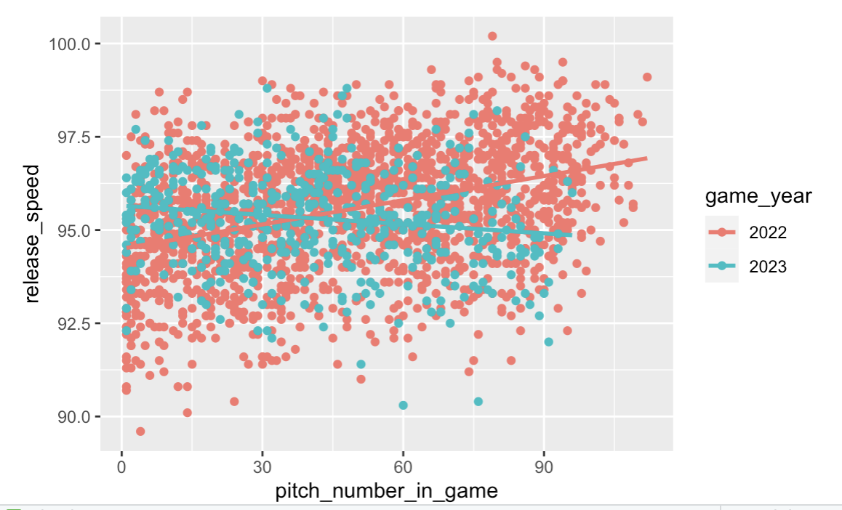
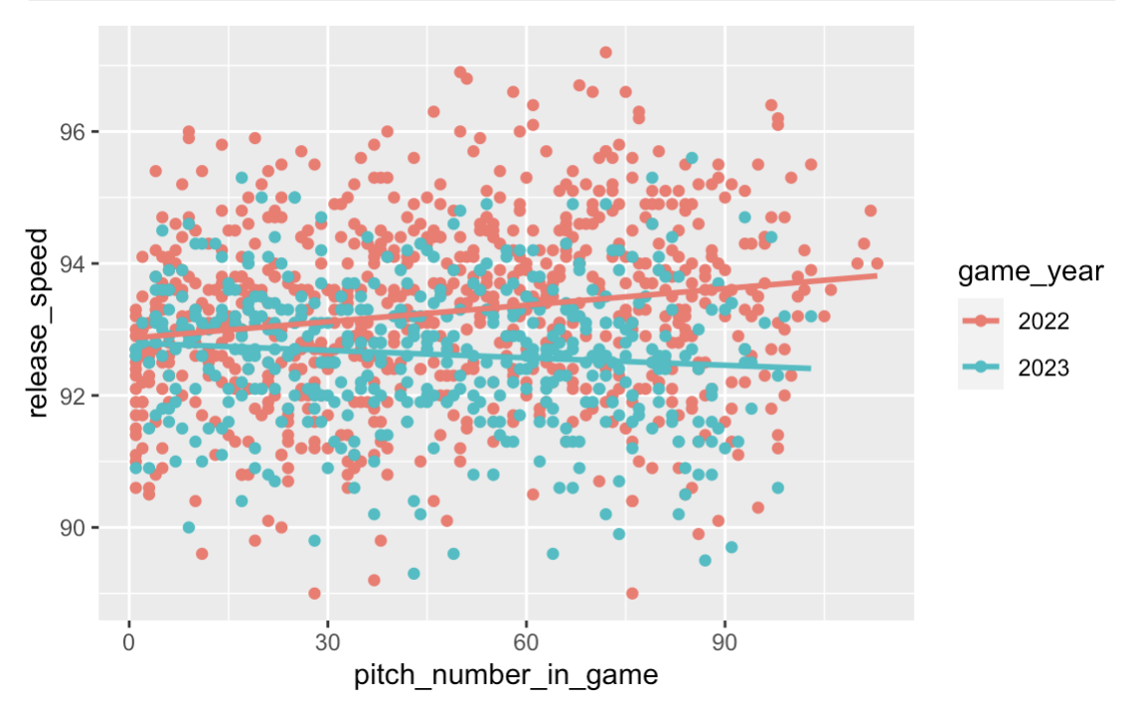
Carlos Rodon Four-Seam Fastball
Alek Manoah Sinker

Slide 7
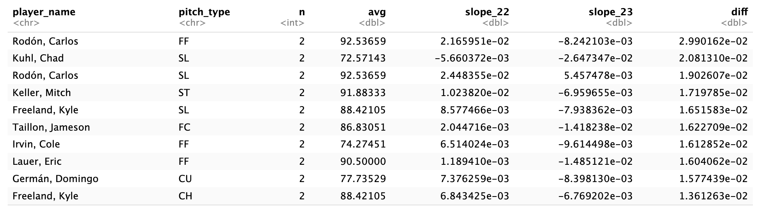
Velocity decrease
The difference in slopes (2022-2023) was calculated for each pitcher/pitch combination
We will use this to quantify the rate of tiredness

Slide 8
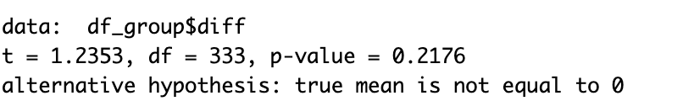
Velocity decrease
We then aggregated these differences across all pitchers to see if they were statistically significant
We found that, with a p-value of 0.2176, the difference was not statistically significant

Slide 9
Pitch Type Analysis Across Years
Certain pitch types are more physically taxing for a pitcher to throw, such as the fastball, because they take more effort to get the desired effect (release_velocity, rpm, etc.)
If pitchers are tiring faster with a pitch clock, are they choosing to throw certain pitches more / less?

Slide 10
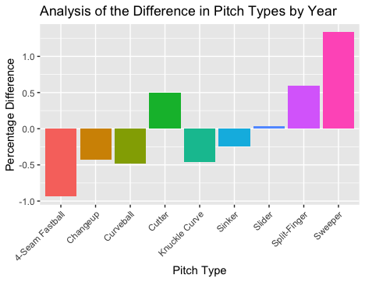
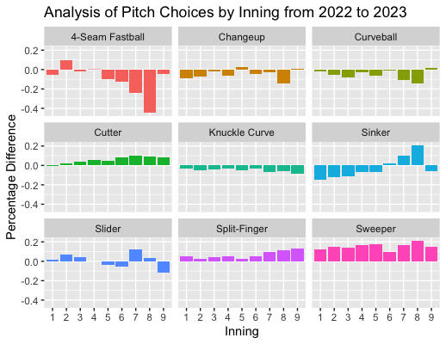
Pitches such as the fastball are being thrown much less in later innings, possibly because it is physically taxing
Some pitches being thrown more / less across the league in 2023

Slide 11
Pitching Accuracy
Does the total number of pitches thrown affect the accuracy of a pitcher?
As the game progresses and the pitch count increases, do pitchers lose accuracy?
Has the implementation of a pitch clock affected this trend between 2022 and 2023?
Can we use accuracy over time as a general measure of “tiredness”?
For this analysis, we take specific pitching increments and compare them across all games from the 2022 and 2023 seasons

Slide 12
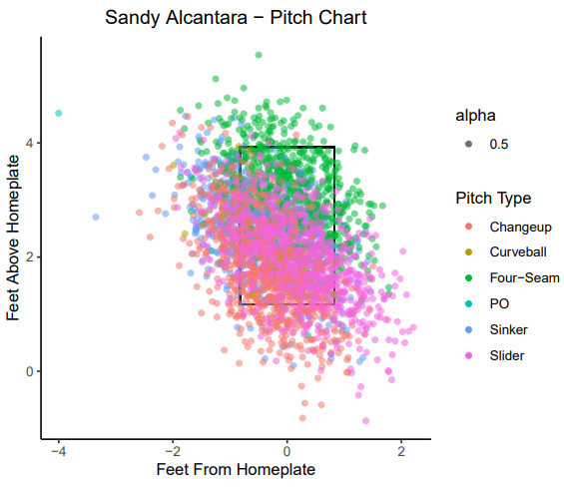
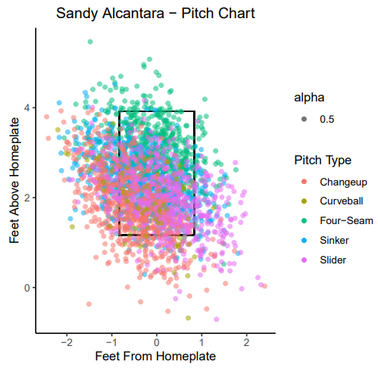
Accuracy Example -
Sandy Alcantara
2022 2023
2022
2023

Slide 13
Accuracy Example
Using data describing the baseball’s relative ‘x_plate’ and ‘z_plate’ locations (feet), we are able to see exactly where each pitch landed, relative to home plate
The strike zone is determined by the width of the plate (‘x_plate’) and estimated based of the average baseball player’s height (‘z_plate’) in the 2022 and 2023 season, respectively
Now, we take pitching increments (20 pitches) across every game in the 2022 and 2023 season and compare their locations graphically

Slide 14
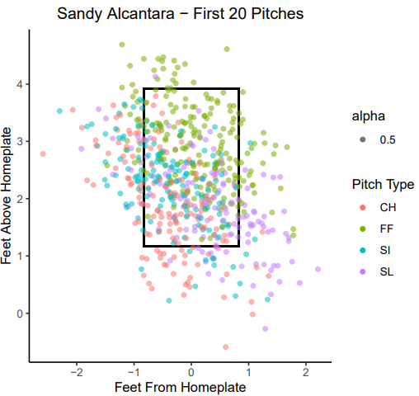
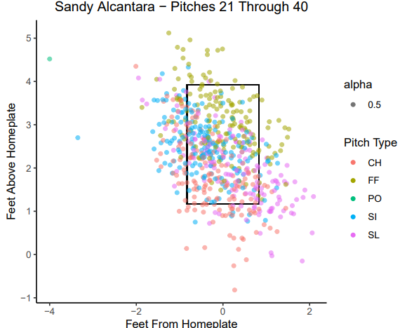
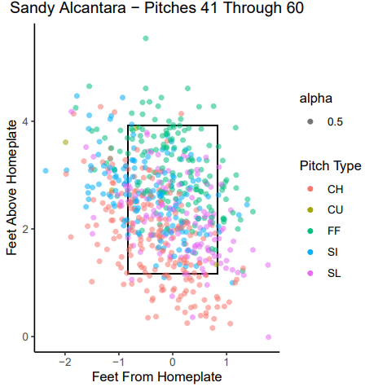
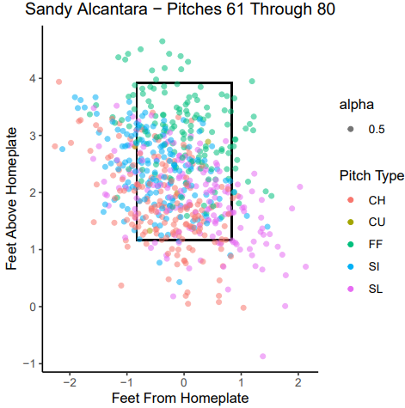
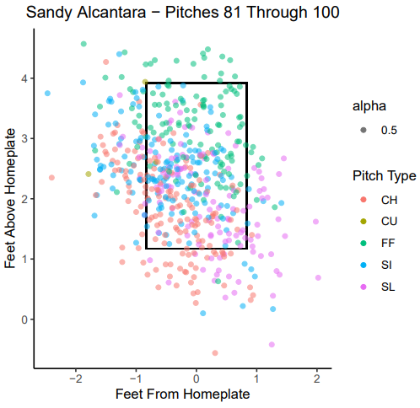
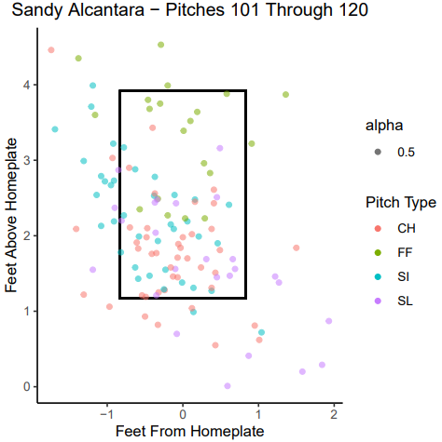
Sandy Alcantara Pitching 2022

Slide 15
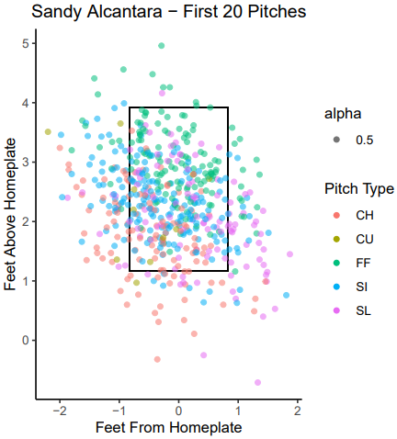
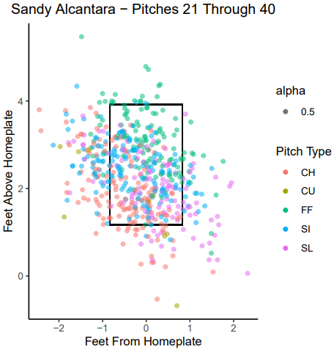
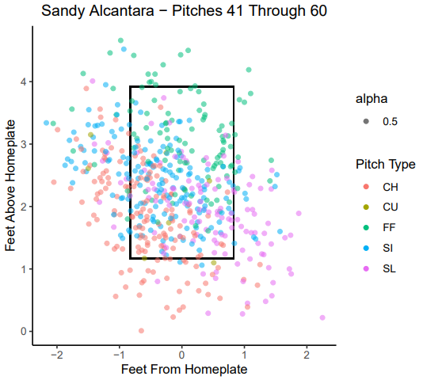
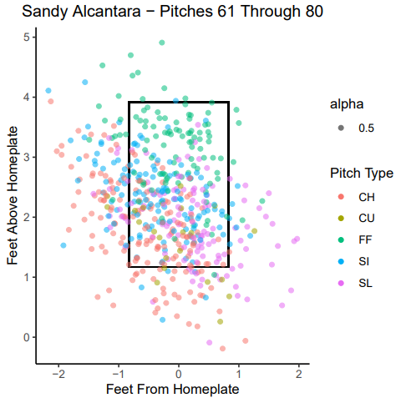
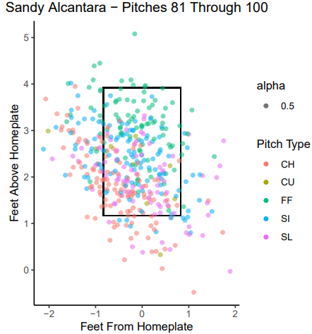
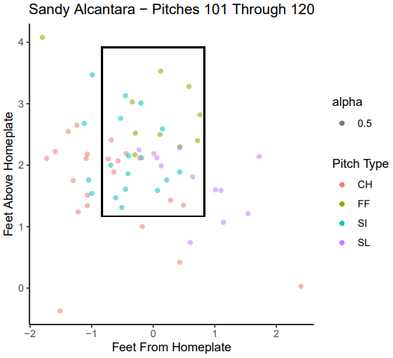
Sandy Alcantara Pitching 2023

Slide 16
Accuracy Example - SA
Accuracy Score | 2022 | 2023
Pitches 1-20 | 61.5625 % | 63.92857 %
Pitches 21-40 | 60.46875 % | 60.0 %
Pitches 41-60 | 63.90625 % | 60.89286 %
Pitches 61-80 | 65.15625 % | 61.93896 %
Pitches 81-100 | 61.3879 % | 61.61137 %
Pitches 101-120 | 65.87302 % | 59.67742 %
General increase in accuracy as pitch count increases for 2022
General decrease in accuracy as pitch count increases for 2023

Slide 17
Accuracy Example - JV
Accuracy Score | 2022 | 2023
Pitches 1-20 | 65.35714 % | 62.96296 %
Pitches 21-40 | 61.96429 % | 61.11111 %
Pitches 41-60 | 63.03571 % | 64.62963 %
Pitches 61-80 | 65.11194 % | 61.33829 %
Pitches 81-100 | 59.27978 % | 61.57635 %
Pitches 101-120 | 46.66667 % | 64.05405 %
General decrease in accuracy as pitch count increases for 2022
General increase in accuracy as pitch count increases for 2023

Slide 18
Accuracy Example
General Notes
Less reliable data for pitches 101 - 120 due to sample size
Strike zone is different for each player, conclusions drawn from average height of MLB players in 2022 and 2023
Sources of random error may affect a pitcher’s general “tiredness” (and therefore accuracy)
Fielding the ball
Attempting to throw a runner out on base
Designated Hitters / Pitchers who hit
Environmental conditions
Notes:
Conclusions were very inconsistent as we measured pitching accuracy across different pitchers and their individual pitch counts. Several confounding factors play into why accuracy increased with less time in between pitches, so we decided to explore other options for our analysis.

Slide 19
Tempo Analysis
First, we explored velocity decreases based on how large of a tempo increase pitchers made
We broke the pitchers into quadrants based on their increase in tempo (and decrease in seconds between pitches) and then compared velocity changes between the groups
We only considered starting pitchers
Relievers see volatile usage scenarios
Notes:
Conclusions were very inconsistent as we measured pitching accuracy across different pitchers and their individual pitch counts. Several confounding factors play into why accuracy increased with less time in between pitches, so we decided to explore other options for our analysis.

Slide 20
Tempo vs. Velocity
Quadrant | Difference in Avg. Seconds between pitches, 2022-2023 | Difference in Avg. Velocity, 2022-2023
Q1 (Highest Increase in Tempo) | -3.79 | -0.38
Q2 | -2.66 | -0.36
Q3 | -2.00 | -0.12
Q4 (Lowest Increase in Tempo) | -0.92 | 0.12
Notes:
Split into quadrants by median 2022 tempo and median difference between 2022 and 2023
If the number is positive, average value was larger in 2023 with pitch clock
If negative, larger in 2022 without pitch clock
Left - pitchers who were slower in 2022 but didnt adjust much after the pitch clock were the only group to show an increase in speed (but very slight), which is surprising
Right - Only group to show an increase in pitch spin rate was the group that didn’t adjust much, but were already letting go of the ball quickly in 2022

Slide 21
Tempo vs. Velocity
We ran significance tests between all permutations of quadrants, comparing velocity changes
The only test that showed significance was when comparing Q1 to Q4, or the highest increase in tempo to the lowest
This shows that on the extremes, the increase in tempo does lead to a velocity decrease
Notes:
Split into quadrants by median 2022 tempo and median difference between 2022 and 2023
If the number is positive, average value was larger in 2023 with pitch clock
If negative, larger in 2022 without pitch clock
Left - pitchers who were slower in 2022 but didnt adjust much after the pitch clock were the only group to show an increase in speed (but very slight), which is surprising
Right - Only group to show an increase in pitch spin rate was the group that didn’t adjust much, but were already letting go of the ball quickly in 2022

Slide 22
ANOVA tests for Tempo w/o Runners On Base
Release Speed
Spin Rate
 | Mean Release Speed Difference | Difference from Overall Mean | Squared Difference | N
Low Difference, High 2022 Tempo | 0.098 | 0.347 | 0.12 | 18
High Difference, High 2022 Tempo | -0.355 | -0.107 | 0.012 | 40
Low Difference, Low 2022 Tempo | -0.166 | 0.082 | 0.007 | 40
High Difference, Low 2022 Tempo | -0.541 | -0.292 | 0.085 | 18
 | Mean RPM Difference | Difference from Overall Mean | Squared Difference | N
Low Difference, High 2022 Tempo | -5.710 | -5.321 | 28.311 | 18
High Difference, High 2022 Tempo | -2.613 | -2.224 | 4.944 | 40
Low Difference, Low 2022 Tempo | 6.618 | 7.007 | 49.102 | 40
High Difference, Low 2022 Tempo | -5.670 | -5.309 | 29.191 | 18
Notes:
Split into quadrants by median 2022 tempo and median difference between 2022 and 2023
If the number is positive, average value was larger in 2023 with pitch clock
If negative, larger in 2022 without pitch clock
First, we looked analyzed release speed and release spin rate when bases were empty
Left - pitchers who were slower in 2022 but didn’t adjust much after the pitch clock was were the only group to show an increase in speed (but very slight), which is surprising
Right - Only group to show an increase in pitch spin rate was the group that didn’t adjust much, but were already letting go of the ball quickly in 2022

Slide 23
ANOVA tests for Tempo w/ Runners On Base
Release Speed
Spin Rate
 | Mean Release Speed Diff | Difference from Overall Mean | Squared Difference | N
Low Difference, High 2022 Tempo | 0.240 | 0.367 | 0.134 | 18
High Difference, High 2022 Tempo | -0.354 | -0.228 | 0.052 | 40
Low Difference, Low 2022 Tempo | 0.059 | 0.185 | 0.034 | 40
High Difference, Low 2022 Tempo | -0.397 | -0.2701 | 0.073 | 18
 | Mean RPM Diff | Difference from Overall Mean | Squared Difference | N
Low Difference, High 2022 Tempo | -6.805 | -6.846 | 46.87 | 18
High Difference, High 2022 Tempo | -0.51 | -0.551 | 0.304 | 40
Low Difference, Low 2022 Tempo | 5.276 | 5.233 | 27.401 | 40
High Difference, Low 2022 Tempo | -3.521 | -3.562 | 12.685 | 18
Notes:
Left - Less adjustment showed an increase in release speed for both groups that had a high and low 2022 tempo
Right - same as with no runners on base, with only the low difference low 2022 tempo

Slide 24
ANOVA tests for Physical Characteristics
Release Speed
Spin Rate
 | Mean Release Speed Diff | Difference from Overall Mean | Squared Difference | N
Young, Lighter | -0.391 | -0.142 | 0.020 | 29
Young, Stockier | -0.039 | 0.211 | 0.044 | 28
Old, Lighter | -0.182 | 0.067 | 0.005 | 30
Old, Stockier | -0.378 | -0.131 | 0.017 | 29
 | Mean RPM Diff | Difference from Overall Mean | Squared Difference | N
Young, Lighter | -11.605 | -11.646 | 135.628 | 29
Young, Stockier | -1.787 | -1.828 | 3.34 | 28
Old, Lighter | 3.520 | 3.479 | 12.104 | 30
Old, Stockier | 10.808 | 10.767 | 115.934 | 29
Notes:
Left - general reduction in release speed across all quadrants, with the biggest difference being in the younger + lighter group and older + stockier group
Right - RPM increase with older pitchers, but rpm decrease with younger pitchers in general

Slide 25
F Statistics
 | Tempo vs Release Speed (no runners) | Tempo vs Spin Rate (no runners) | Tempo vs Release Speed (with runners) | Tempo vs Spin Rate (with runners) | Physical Traits vs Release Speed | Physical Traits vs Spin Rate
Mean Squared Error | 0.855 | 2578.507 | 0.966 | 2654.082 | 0​​.873 | 2604.236
F Ratio | 1.726 | 0.411 | 2.478 | 0.274 | 0.94 | 0.994
F Statistic at 5% Significance | 2.686 | 2.686 | 2.686 | 2.686 | 2.686 | 2.686
Significant? | No | No | No | No | No | No

Slide 26
Limitations
Only 1 year’s worth of observations
We aren’t able to see how pitchers adjust to the pitch clock over a larger span of time
Tempo data aggregation
Tempo data was aggregated by pitcher over the year, so we weren’t able to do a more fine-tuned analysis on tempo effects
Lack of pitch violation frequency
The pitch violations couldn’t be explored as the number of violations per pitcher are very low
Notes:
Anusha

Slide 27
Conclusions
Our analysis showed a general insignificance
Through the grand majority of our tests, the results were insignificant
This can quell some of the concerns raised by players and fans about the pitch clock’s adverse effects on the game
Overall this is a positive for the MLB, as the pitch clock has had the intended effect of shortening games without compromising performance.

Slide 28
Future Work
Combine batting performance with pitching performance
Are pitchers who are faced with a top-tier batter or base-runner more likely to crumble under pressure?
Is it better to take your time with a better performer on the plate, or does that not make a significant difference?
How do pitchers with lengthy pre-pitch routines perform across 2022 and 2023?
With the implementation of a pitch clock, how do the stats of pitchers with lengthy pitch routines compare across seasons with and without pitch clock rule?
Notes:
One possible angle could be combining pitcher data with batter data and looking into whether pitchers perform worse when restricted by time and faced with a batter with an above average batting percentage. Are pitchers who are faced with a top-tier batter or base-runner more likely to crumble under pressure? Is it better to take your time with a better performer on the plate, or does that not make a significant difference?
Another angle would be to apply a similar form of analysis that we did with pitcher data on batter data, and evaluate whether pitchers who had lengthy pre-pitch routines (and now can’t do those anymore) perform better or worse on the plate?

Slide 29
Thank you!

